Slide 1

Device Class
Attributes and Methods

Slide 2
Purpose
The Device class is the base class which defines attributes used within both the phone and tablet classes.
This class provides information to the derived classes about model, price, and release year.

Slide 3
Attributes
Strings
model: What model is the device
price: Cost of the device
Integer
releaseYear: Year device was released

Slide 4
Methods
Setters
setModel: assigns model of device
setReleaseYear: sets device production year
setPrice: sets device prices
Getters
getModel: returns model
getReleaseYear: returns device year
getPrice: returns device price

Slide 5
Methods cont…
displayData:
This method displays all product information such as Model Name, Production Year, and Price. Both Phone and Tablet classes call this method to display their respective information.

Slide 6
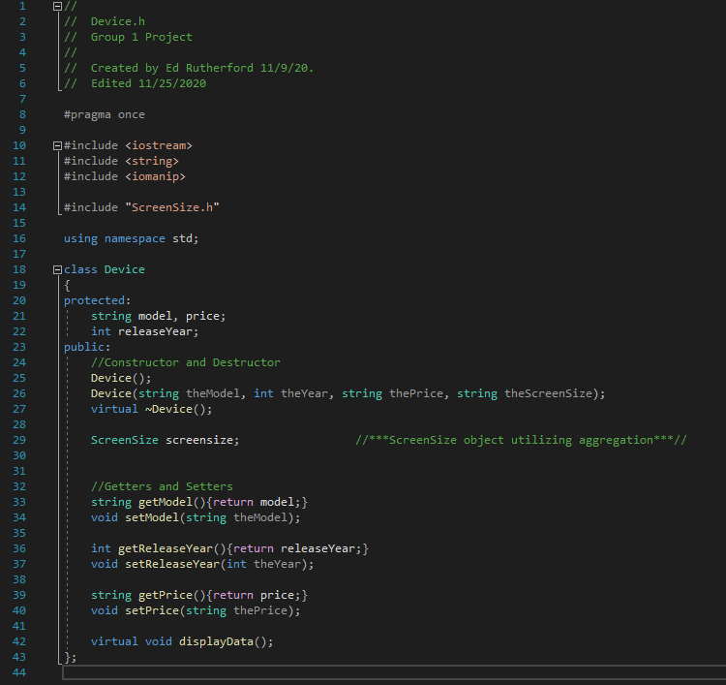
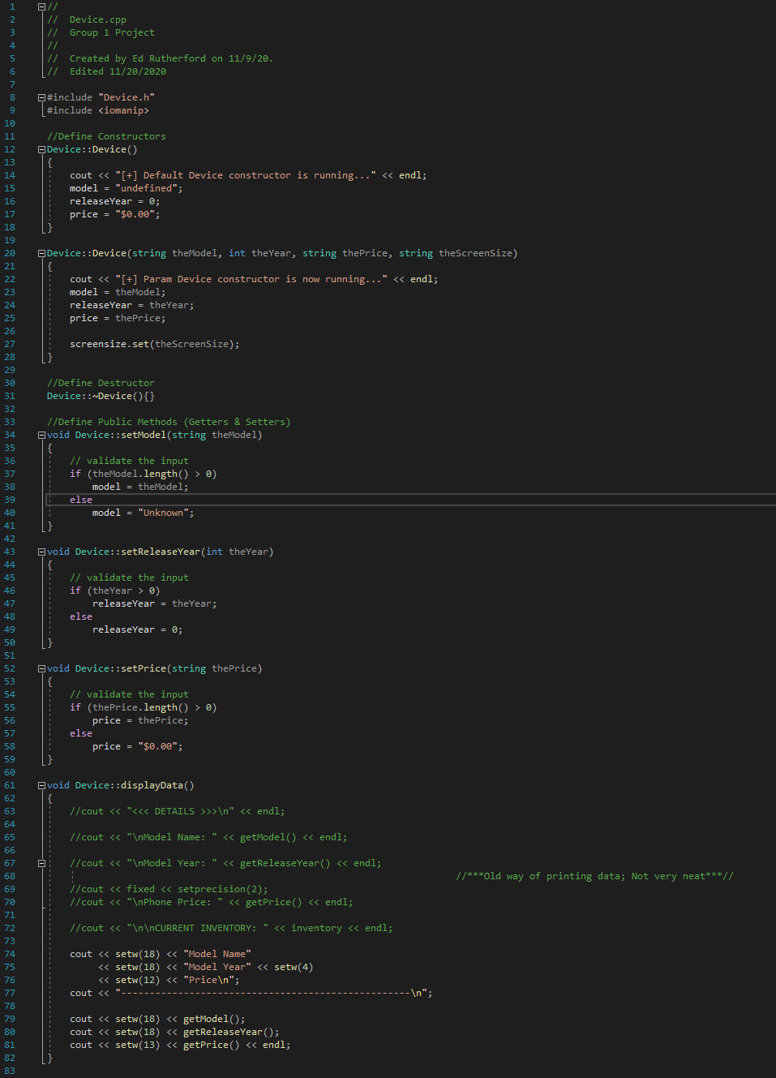
Device Class Code Screenshot

Slide 7



Tablet Class
Attributes and methods

Slide 8
purpose
The purpose of the tablet class is to define an object for tablet devices, which are composed of the same base attributes as their parent.
This class inherits from the Device base class.

Slide 9
attributes
Inventory

Slide 10
methods
getInventory : Returns the value stored in the ‘inventory’ private attribute.
setInventory : Assigns a value to the ‘inventory’ private attribute.
displayData : Prints attribute values to standard output. Utilizes static binding and reuse of the Base Class ‘displayData’ method.

Slide 11
Fray Contreras
Date: 12/3/2020
Class: CIS247

Slide 12

Plan Class
Attributes and Methods

Slide 13
Purpose
The purpose of the plan class is to define the different types of plans available to the users.
This class inherits from the Device base class.

Slide 14
Attributes
Name: The name of the plan selected.
Price: The price of the plan selected.
Contract Length: The length of the selected plan.

Slide 15
Methods
getName: Returns name variable.
setName: Assigns the plan’s name.
getPrice: Returns Price variable.
setPrice: Assign’s the plan’s price.
getContractLength: Returns Contract Length Variable.
setContractLength: Assigns the plan’s Contract Length.
displayData: Prints the stored information into the output stream for a given object.

Slide 16
James Finch
Date : 12/2/2020
Class : CIS247

